Slide 1
PROBABILITY

Slide 2
PROBABILITY
What is empirical probability?
What is theoretical probability?
Empirical probability is the relative frequency of occurrence of an event determined by actual observations of an experiment.
Theoretical probability is determined through a study of the possible outcomes that can occur for the given experiment.

Slide 3
Theoretical Probability
What is the probability of rolling a 7?
Each die has 6 sides. Possible rolls include (1,1), (1,2), (1,3), (1,4), (1,5), (1,6) ….. (6,6)

Slide 4
(1,6), (2,5), (3,4), (4,3), (5,2), (6,1)
There is 1 in 6 probability of rolling a combination that equals 7 theoretically.

Slide 5
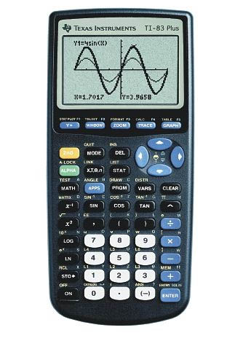
Let’s Experiment!!

Slide 6
Emperical Probability
What are the chances of it landing heads up?
50 times
34 times the coin landed heads up

Slide 8
Theoretical?
Emperical ?

